Slide 1
Comprehensive VHDL Hamdi Abdelbagi Phone: (937) 830-7761 Email: abdelbagih1@udayton.edu

Slide 2
Introduction
Aim
To obtain general appreciation of what VHDL is, and how it is used in design process
Topics covered
What is VHDL?
History of VHDL
VHDL design flow and tools
SRAM-based FPGAs
Benefits of VHDL
VHDL resources

Slide 3
What is VHDL
VHDL is VHSIC Hardware Description Language
VHSIC = Very High Speed integrated Circuit
IEEE standard 1076, defined by Language Reference Manual
All rights were given away be the DoD to the IEEE
1987 Publication of IEEE Standard 1076-1987
1994 - Revised standard , VHDL 1076-1993
2000 – Revised edition incorporating
2002 – Revised edition incorporating 1076-2000 plus buffer port changes
To use VHDL at all, you need to learn the language; but to use VHDL effectively you need to learn how tools especially synthesis too interpret your VHDL.
Effective VHDL = Know VHDL + Know how tools interpret VHDL

Slide 4
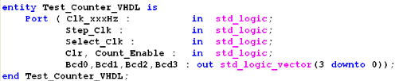
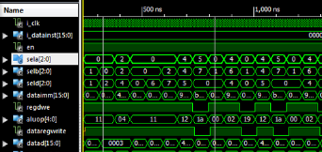
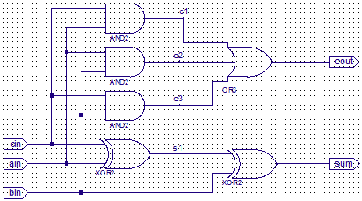
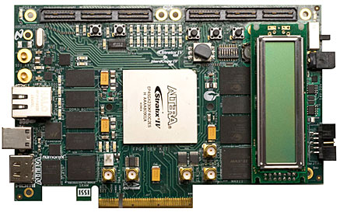
Design Flow
Design Entry (Design RTL, testbench)
Simulation(verification, debugging)
Synthesis/Fitting(Deign, no TB)
Hardware (bitstream, mask)

Slide 5
Tools
Design Capture:
Text editor, graphical entry, SM entry…
Simulator:
Simulation testbench (non-synthesisable) and design (synthesisable) to verify fictional correctness.
Synthesis Tool:
Translate synthesisable code into gate level netlist in chosen technology
Netlist Mapping:
R-Map gate level netlist to technology primitive cells
Place and Route:
Place cells on chip and route wiring
Time Analysis:
Analyze time “Static Timing Analysis”
Hardware:
Produce masks (application-specific integrated circuit (ASIC)), bitstream (FPGA)

Slide 6
SRAM-based FPGA

Slide 7
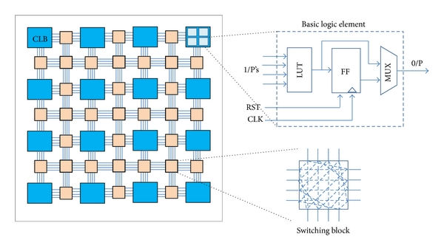
SRAM-based FPGA
CLB: Configurable Logic Block

Slide 8
SRAM-FPGAs Typical Logic Block
Typical Logic Cell can include 1,2, or up to 4 registers
Every Architecture is compromise:
Usually allergic to very wide combinational faction
C-logic is wasted when too many FFs are used

Slide 9
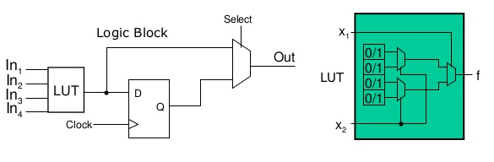
FPGA Logic Block
The storage cells in the LUPs in an FPGA are volatile
Losing stored contents whenever the power is off
Using PROM to hold data permanently
The storage cells are loaded automatically from PROM when the chip is initialized

Slide 10
FPGA Extra Feature
In-system configurability
Start-up block, Oscillators
RAM/ROM/CAM-Content-addressable memory
Dedicated and/or distributed
PLLs and Clock-related feature
Specific high speed IO standard (LVDS, GTS (Global Three State)….)
Bus interface (PCI)
Embedded microprocessor cores
ETC…

Slide 11
Benefits of VHDL
Executable specification
Validate specs in system contact. Subcontract
Functionality separated from implementation
simulate early and fast. Mange complexity
Explore design alternatives
get feedback. Produce better design
Automatic synthesis and test generation
Increase productivity. Shorten time to market
Protect your investment

Slide 12
VHDL World
VHDL on the internet

Slide 13
Getting Started
Aim
To understand the overall flow of VHDL project
Topics covered
entity, port and architecture
Testbenches
Libraries and compilation
tool flows

Slide 14
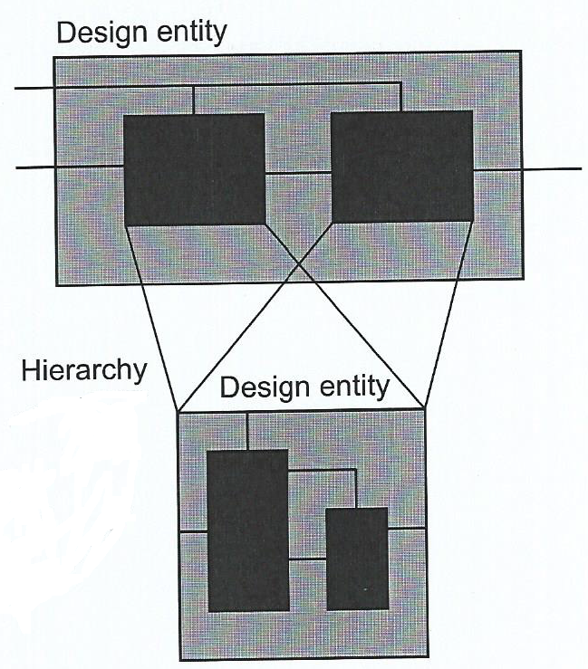
The Design Entity
Examples:
Printed circuit board
Microprocessor
CPLD
Counter
AND gate

Slide 15
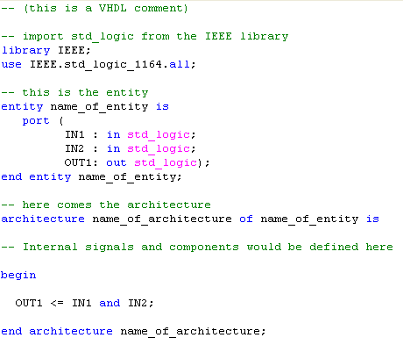
Entity, Port and Architecture
Entity
A module
Port
external connections
Architecture
functionality

Slide 16
Testbenches
Testbench
Any entity without ports
Instantiation
The device under test
Signals
Wired connections
Stimulus
Process to drive inputs

Slide 17
Testbench

Slide 18
Stimulus Process
Process statements execute sequentially
Sequential signal assignments schedule new value
Wait statements pause process

Slide 19
Compilation

Slide 20
Compilation Order
VHDL file 2 instantiates design unit from VHDL file 1
Compile VHDL file 1 into the library first

Slide 21
Typical Functional Simulation Flow
All simulators follow these steps
Most simulators support TCL scripting
TCL = Tool Command Language
Script automation improve productivity
Repeatable operation
Executable documentation
Saves time

Slide 22
Typical Synthesis Flow
Synthesis tool can be:
Stand alone
Integrated with FPGA tool suite
Common feature include:
FSM optimization
Resource sharing
RTL view
Technology view
Synthesis can be scripted

Slide 23
Recommended Design Style for Sythesis
All storage is flip-flops with a single external clock
No combinational feedback loops

Slide 24
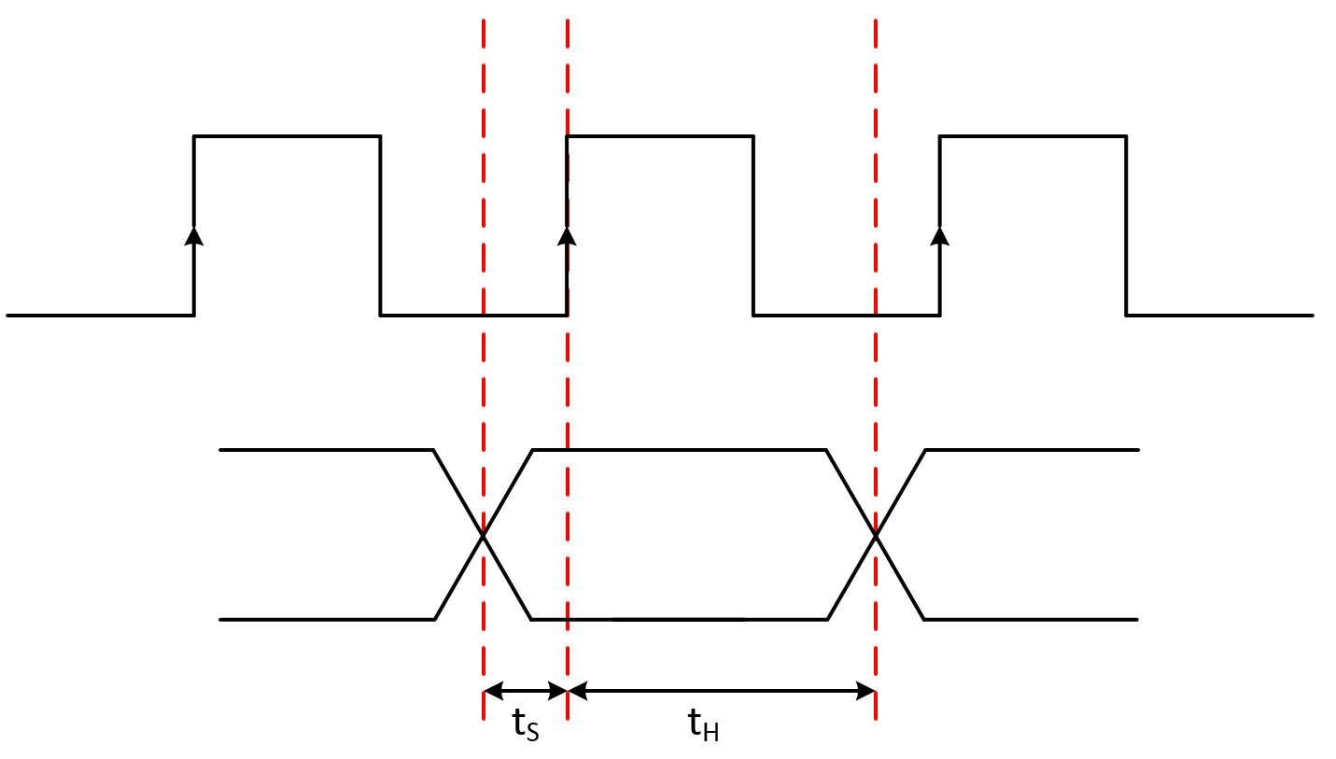
Timing Constraints

Slide 25
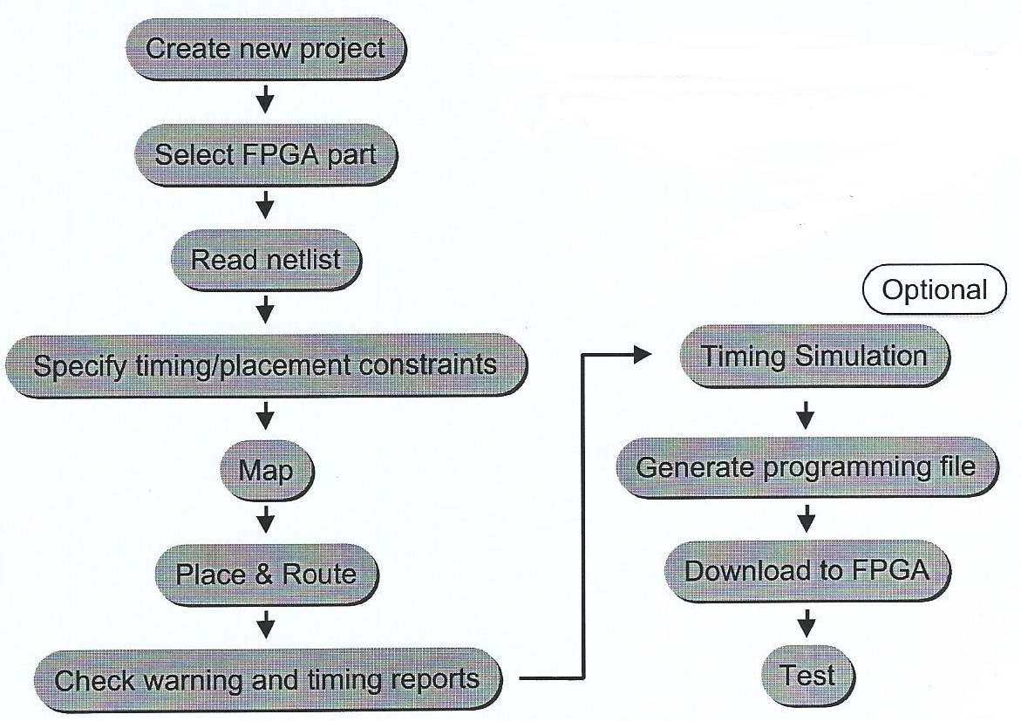
Typical FPGA implementation Flow
Tools are provided by FPGA vendor
Implementation can be scripted

